Slide 1
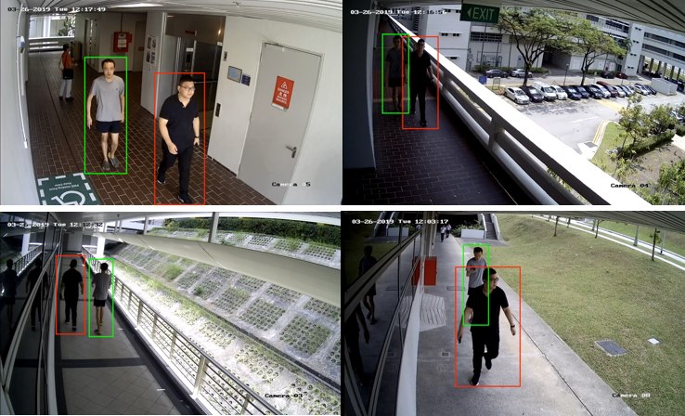
Improvements in Person Identification in Video under constraints
Project code: 25-1-R-20
Capstone Project Phase A - 61998
Asad Saffouri
Alexandra Simonishvili
Supervisor: Mr. Ilya Zeldner

Slide 2
Overview
Introduction | 3
System solution | 4-5
System Flow | 6
YOLOv8 | 7
FaceNet | 8
FlowNet | 9
Architecture | 10
Diagrams & Pseudo Code | 11-16
System Activity Diagram | 17
GUI | 18-20
Expected Problems | 21
Evaluation Plan | 22

Slide 3
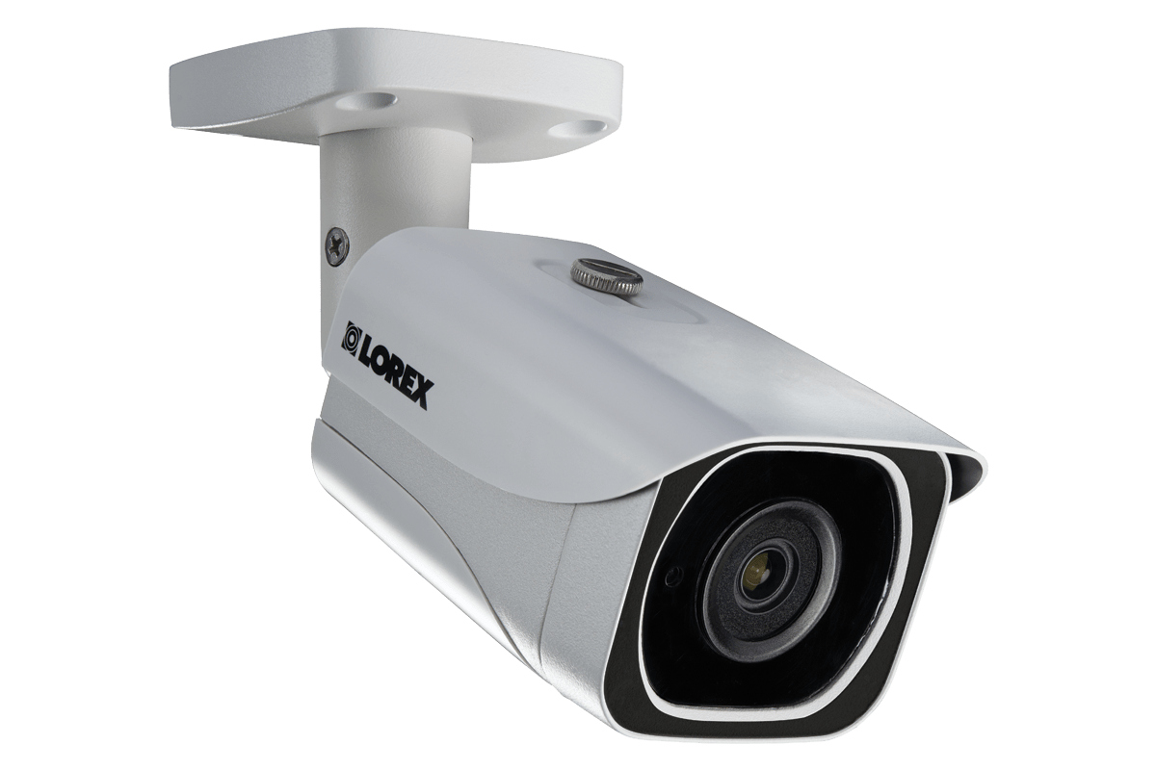
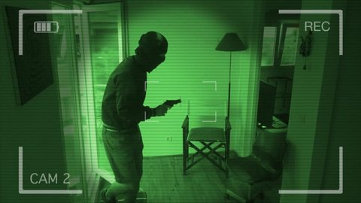
Introduction
There is a high demand for accurate person identification and continuous tracking under various conditions and constraints, such as changing lighting, movement, and partial or full obscurity.
High impact in fields like:
security, media, production regulation
smart devices and vision,
public safety and emergency response

Slide 4

Existing Solution
Object Detection
Using YOLO Model
Facial Recognition
Using FaceNet Model
Integrate YOLO and FaceNet
User-Friendly Interface
Notes:
Reference : Yolo : Redmon, J., Divvala, S., Girshick, R., & Farhadi, A. (2016). You only look once: Unified, real-time object detection. In Proceedings of the IEEE conference on computer vision and pattern recognition (pp. 779-788).‏ FaceNet : Schroff, F., Kalenichenko, D., & Philbin, J. (2015). Facenet: A unified embedding for face recognition and clustering. In Proceedings of the IEEE conference on computer vision and pattern recognition (pp. 815-823).‏‏

Slide 5
Our Updated Solution
Object Detection
Using YOLO Model
Facial Recognition
Using FaceNet Model
Integrate YOLO and FaceNet
User-Friendly Interface
Motion Tracking
Using FlowNet
04
Notes:
Reference : Yolo : Redmon, J., Divvala, S., Girshick, R., & Farhadi, A. (2016). You only look once: Unified, real-time object detection. In Proceedings of the IEEE conference on computer vision and pattern recognition (pp. 779-788).‏ FaceNet : Schroff, F., Kalenichenko, D., & Philbin, J. (2015). Facenet: A unified embedding for face recognition and clustering. In Proceedings of the IEEE conference on computer vision and pattern recognition (pp. 815-823).‏‏

Slide 6
System Flow
Store frame
Isolation of suspect object as a person
Running face recognition by FaceNet
Upload person’s face images
Identify suspicious object as persons in the frames by YOLO
Yes
Split the video into frames
Is a Person?
Found person matching the photos?
Upload video
No
No
Skip frame
No
Found moving object?
Yes
Yes
Bound the person in frame
Update person’s face images Data
Detect moving objects by FlowNet in the bounded area
No more frames?
Compare current frame with previous frame by FlowNet
Return all frames
Return updated images data

Slide 7
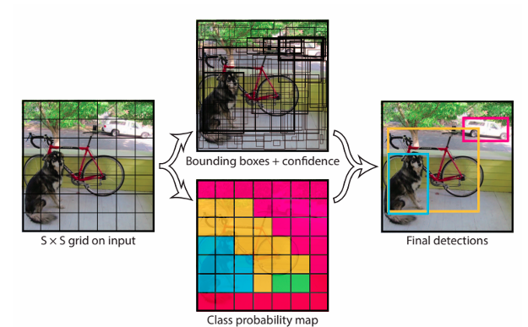
YOLOv8 (You Only Look Once)
An Object detection system
Single convolutional neural network
Input image is divided into a grid system
Each cell is responsible for detecting objects within itself
Draws predicted bounding boxes
Predicts object class probabilities

Slide 8
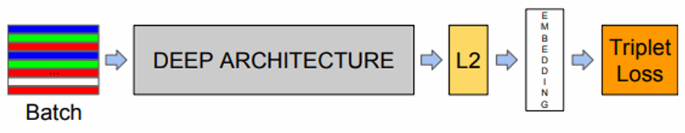
FaceNet (Facial recognition model)
Transforms facial images into a Euclidian space
Uses deep CNN for feature extraction, embedding layer for fixed-size vector representation, and triplet loss for optimized face similarity.
Works well with different conditions like poses, lightning, expression.

Slide 9
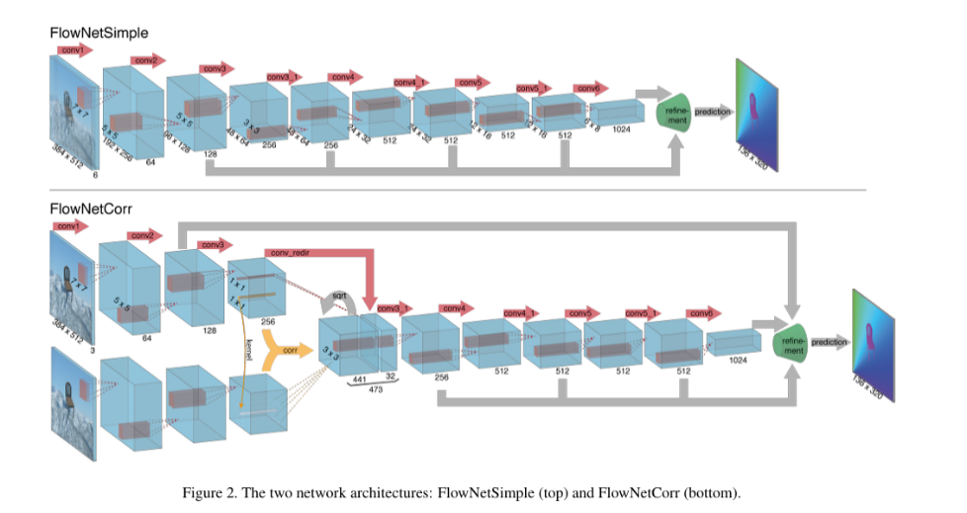
FlowNet (Optical Flow)
A deep learning framework for optical flow estimation in video analysis.
Measures object, surface, or edge movement between video frames, creating a dense map of motion vectors.
First CNN that learns optical flow directly from data in an end-to-end manner (no handcrafted features).
Takes two consecutive frames as input and predicts motion vectors for each pixel.

Slide 10
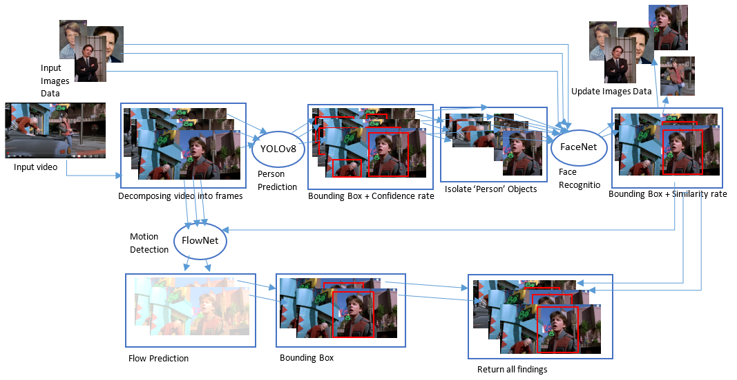
Architecture

Slide 11
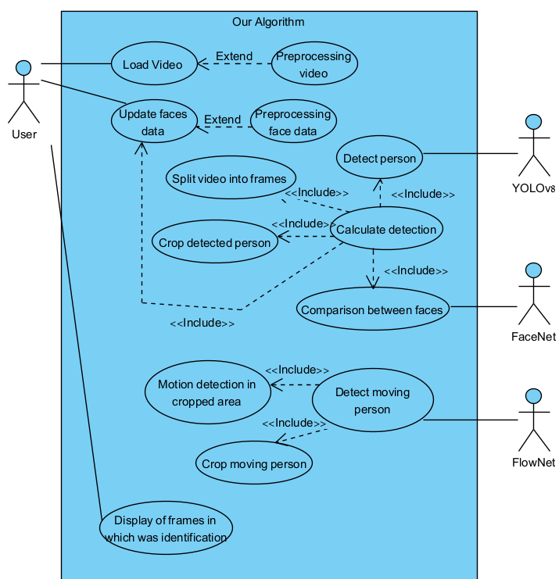
Use Case Diagram
– Full System View

Slide 12
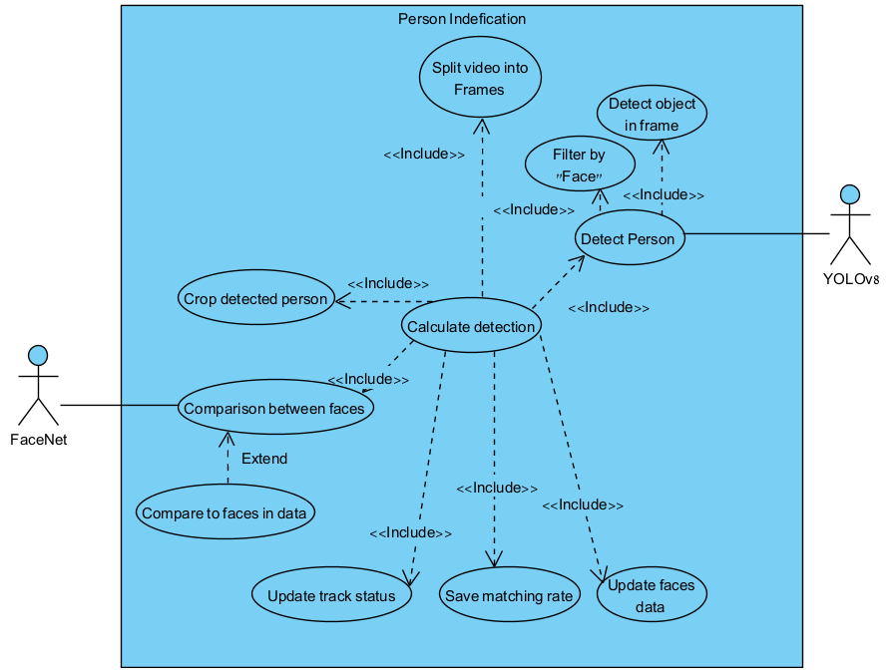
Use Case Diagram
– Person detection by YOLO+ identification by FaceNet

Slide 13
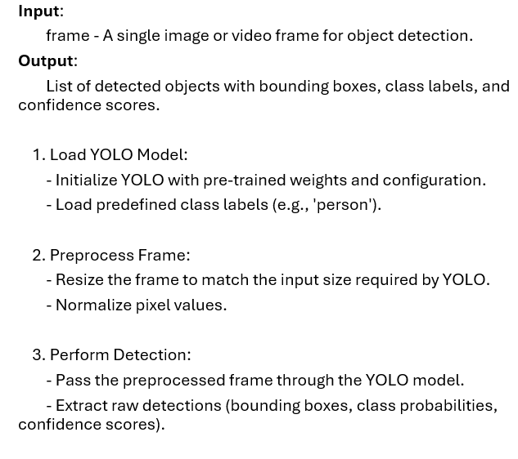
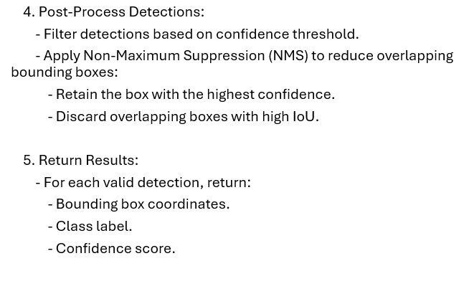
YOLO Pseudo-Code

Slide 14
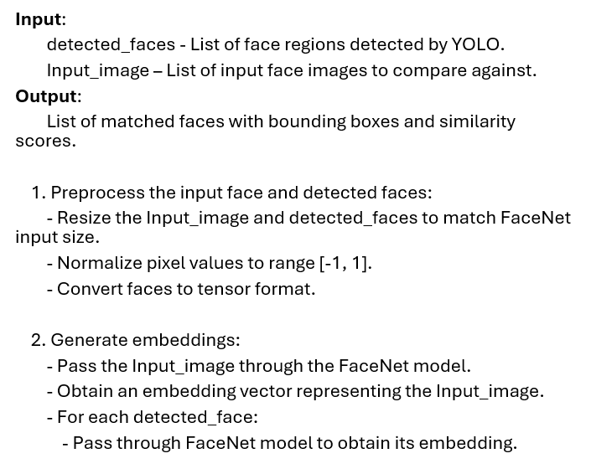
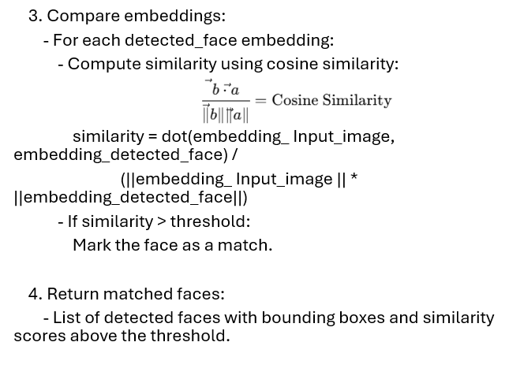
FaceNet Pseudo-Code

Slide 15
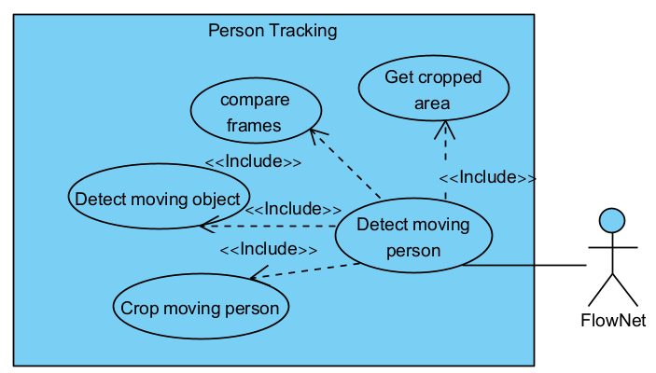
– Person Tracking by FlowNet
Use Case Diagram

Slide 16
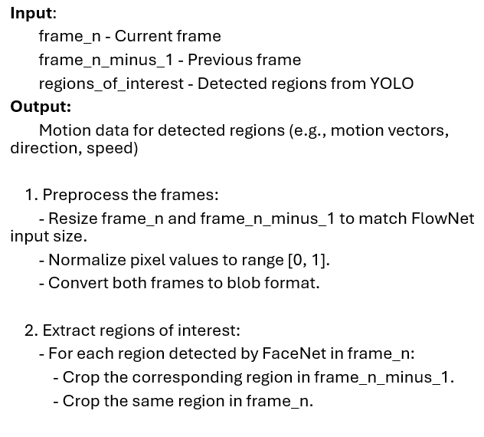
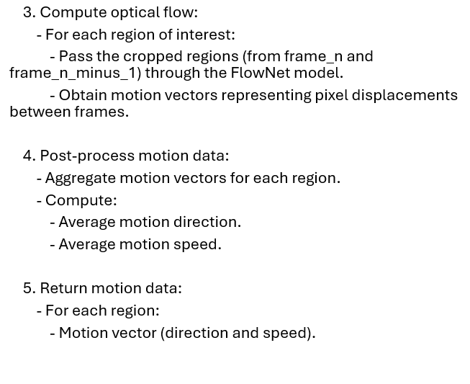
FlowNet Pseudo-Code

Slide 17
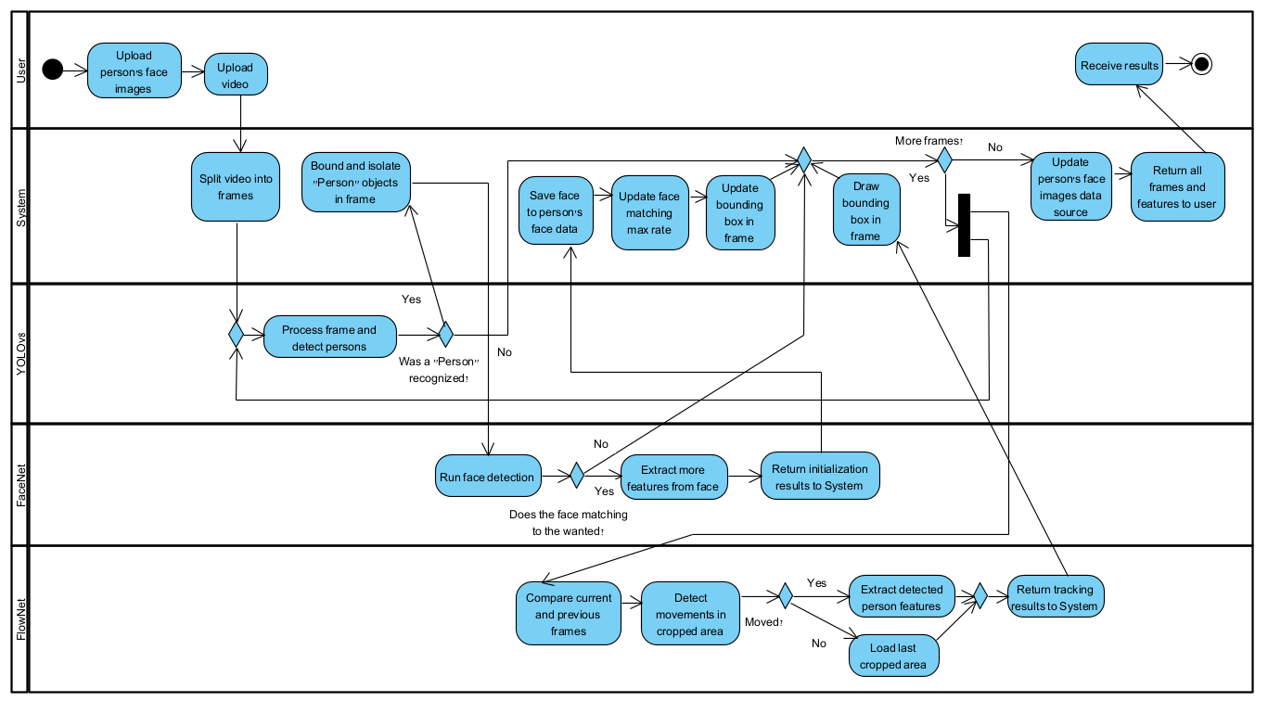
Activity Diagram

Slide 18
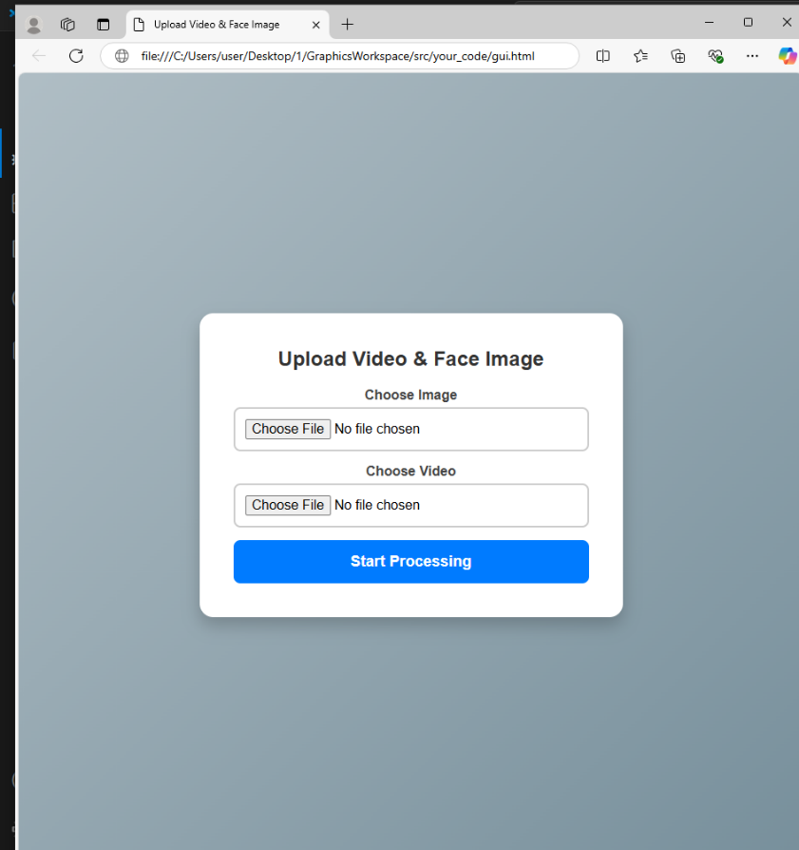
User Interface

Slide 19
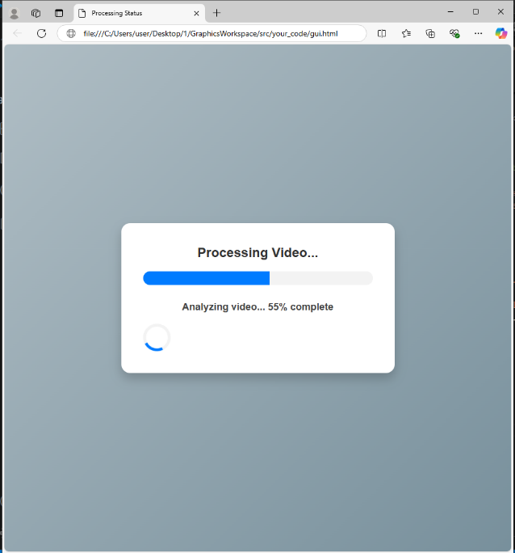

User Interface

Slide 20
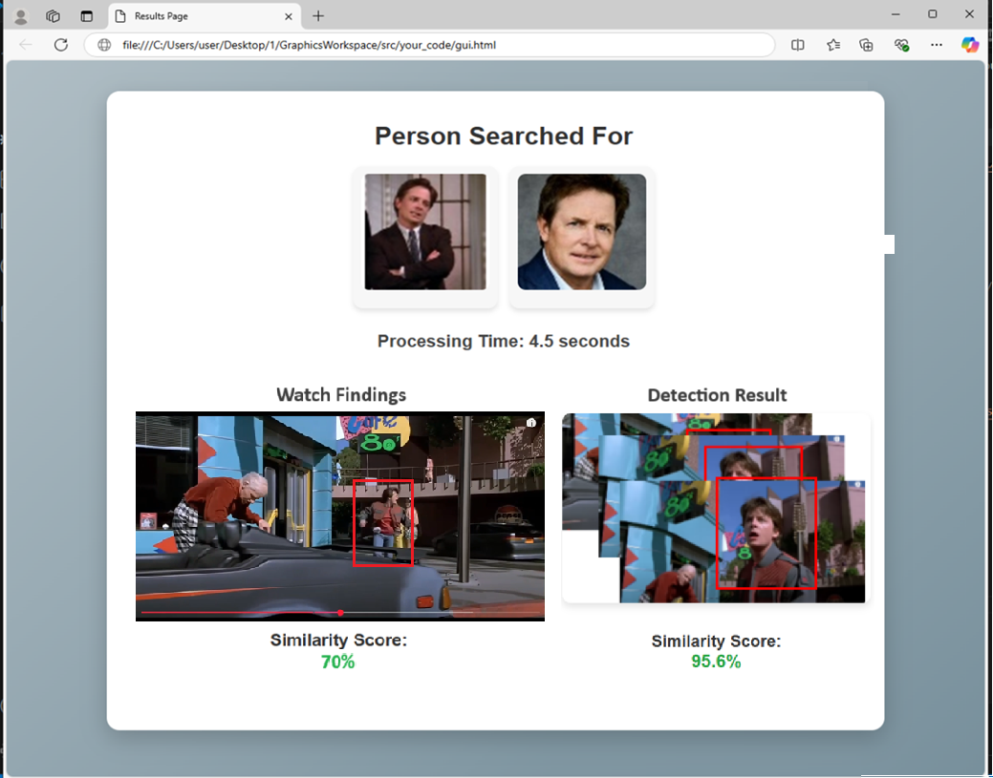
User Interface

Slide 21

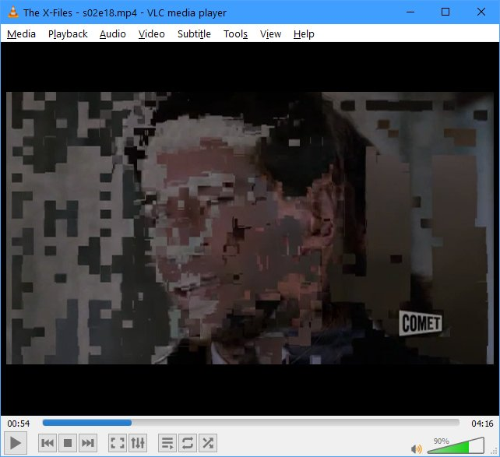
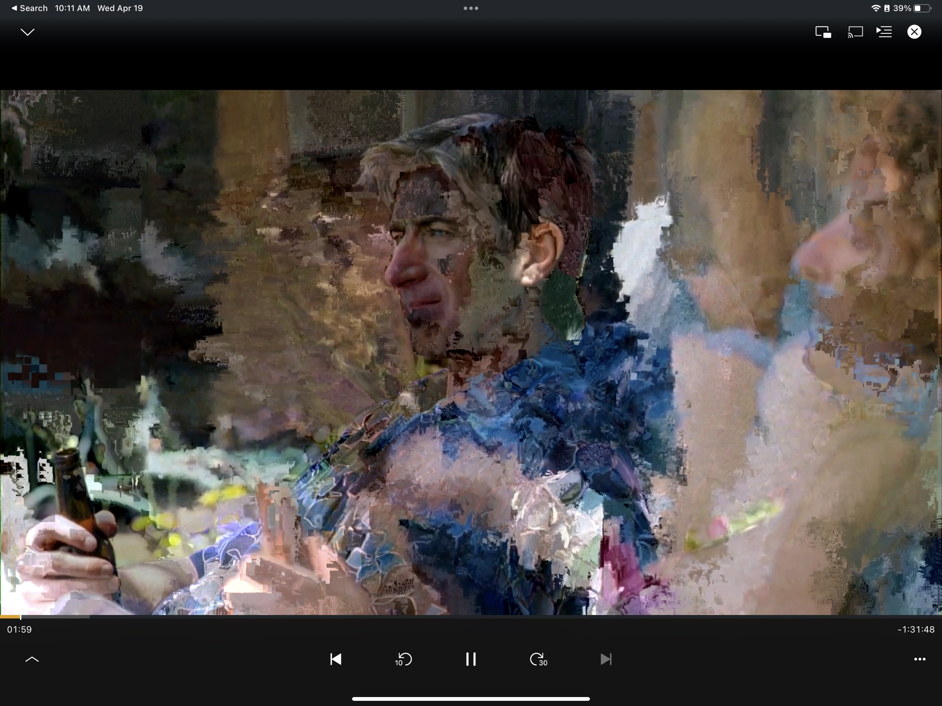
Expected Problems
Real time performance
Low video quality
Cross domain generalization

Slide 22
Evaluation Plan
Test Case | Test Description | Expected Result
Upload Video and Image | Verify that the user can successfully upload a video and an image. | Both files should be successfully uploaded.
Detect Persons Using YOLO | Verify that the system detects persons in each frame using YOLO. | Persons should be detected with bounding boxes surrounding them.
Generate Embedding’s Using FaceNet | Verify that the system generates embedding is for detected faces. | The system should generate a unique embedding for each detected face.
Analyze Motion Using FlowNet | Verify that the system analyzes motion between consecutive frames. | Motion data should be generated for detected persons between frames
Track Detected Persons Across Frames | Verify that the system tracks detected persons across multiple frames | Persons should be consistently tracked across frames.

Slide 23
THANK YOU!

Slide 24
References:
[1] Ron Harel & Itay Benjamin (2024). AI-Driven Person Recognition and Identification in Videos.
[2] Schroff, F., Kalenichenko, D., & Philbin, J. (2015). Facenet: A unified embedding for face recognition and clustering. In Proceedings of the IEEE conference on computer vision and pattern recognition (pp. 815-823).
[3] Dosovitskiy, A., Fischer, P., Ilg, E., Hausser, P., Hazirbas, C., Golkov, V., Van Der Smagt, P., Cremers, D., & Brox, T. (2015). FlowNet: Learning Optical Flow with Convolutional Networks. IEEE International Conference on Computer Vision (ICCV).
[4] Horn, B. K. P., & Schunck, B. G. (1981). Determining optical flow. Artificial Intelligence, 17(1-3), 185–203.
[5] Lucas, B. D., & Kanade, T. (1981). An iterative image registration technique with an application to stereo vision. Proceedings of the 7th International Joint Conference on Artificial Intelligence (IJCAI).
[6] Redmon, J., Divvala, S., Girshick, R., & Farhadi, A. (2016). You only look once: Unified, real-time object detection. In Proceedings of the IEEE conference on computer vision and pattern recognition (pp. 779-788).
[7] Cao, Q., Shen, L., Xie, W., Parkhi, O. M., & Zisserman, A. (2018, May). Vggface2: A dataset for recognising faces across pose and age. In 2018 13th IEEE international conference on automatic face &gesture recognition (FG 2018) (pp. 67-74). IEEE.
[8] Wang, M., & Deng, W. (2021). Deep face recognition: A survey. Neurocomputing, 429, 215-244.
[9] Jeremy Cohen. (2023 September). Computer Vision and Deep Learning: From Image to Video Analysis.

Slide 25
[10] Krizhevsky, A., Sutskever, I., & Hinton, G. E. (2012). Imagenet classification with deep convolutional neural networks. Advances in neural information processing systems, 25
[11] Wang, P., Li, W., Gao, Z., Tang, C., & Ogunbona, P. O. (2018). Depth pooling based large-scale 3-d action recognition with convolutional neural networks. IEEE Transactions on Multimedia, 20(5), 1051-1061.
[12] Redmon, J., Divvala, S., Girshick, R., & Farhadi, A. (2016). You only look once: Unified, real-time object detection. In Proceedings of the IEEE conference on computer vision and pattern recognition (pp. 779-788).
[13] FlowNet Pseudocode: GitHub - ClementPinard/FlowNetPytorch: Pytorch implementation of FlowNet by Dosovitskiy et al.
[14] FlowNetCorr Pseudocode: FlowNetPytorch/models/FlowNetC.py at master · ClementPinard/FlowNetPytorch · GitHub
[15] FlowNetSimple Pseudocode: FlowNetPytorch/models/FlowNetS.py at master · ClementPinard/FlowNetPytorch · GitHub
[16] YOLO Pseudocode: YOLO Pseudocode.py · GitHub
[17] Python: Welcome to Python.org
[18] React: React
[19] Cocodataset official COCO - Common Objects in Context
[20] FiftyOne Integrations COCO Integration: COCO Integration — FiftyOne 1.3.0 documentation
[21] images of person detection : https://www.ntu.edu.sg/rose/research-focus/deep-learning-video-analytics/person-re-identification

